Slide 1
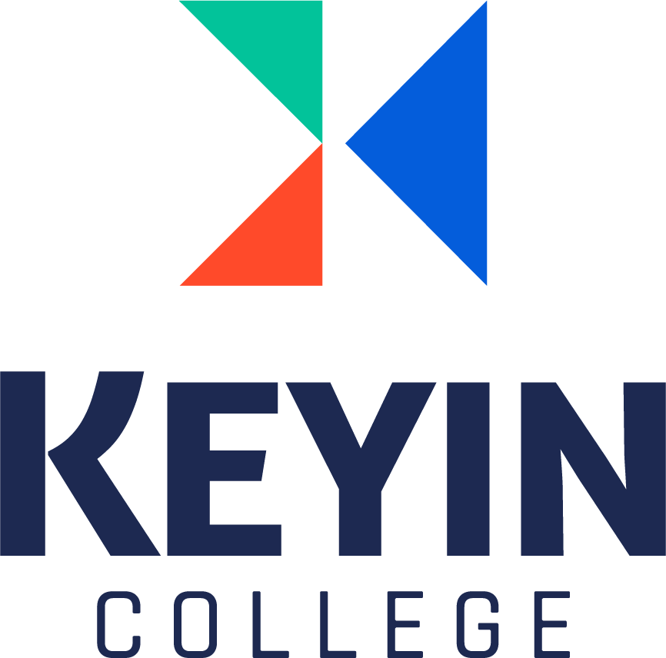
v
DevOps
Suresh
May 05, 2022

Slide 2
Contents
Waterfall model
Agile Model
What is DevOps?
DevOps Phases
DevOps Tools
DevOps Advantages

Slide 3
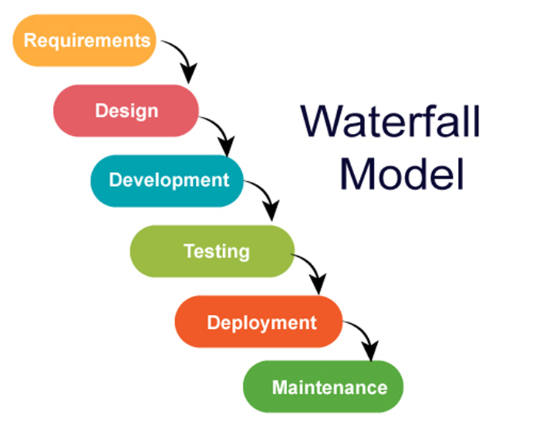
Waterfall Model
Waterfall Model is a sequential software development process, where progress flows steadily toward the conclusion through the phases of a project.

Slide 4
Disadvantages of Waterfall Model
Client requirements can't be known at once.
Any new requirements from the clients need to start the whole developments cycle
It is very expensive to make changes in the final stages of the project.
Software must be developed with limited resources and fast response is expected.

Slide 5
Agile Model
Agile methodology takes an iterative approach to software development.
Unlike straightforward linear waterfall model, agile projects consists of number of smaller cycles which we usually refer as sprints or iterations.
Consists of small, self-organizing teams of software developers and business representatives regularly meeting in person throughout the software development life-cycle.

Slide 6
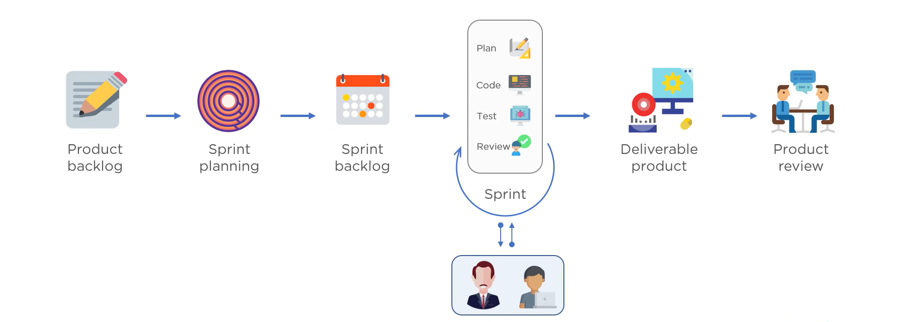
Agile Model

Slide 7
Agile Model
Advantages
Client's requirements are better understood because of the constant feedback.
Product is delivered much faster as compared to waterfall model.
Disadvantages
The product gets tested only on developer computers.
Developers and operations teamwork in silos

Slide 8
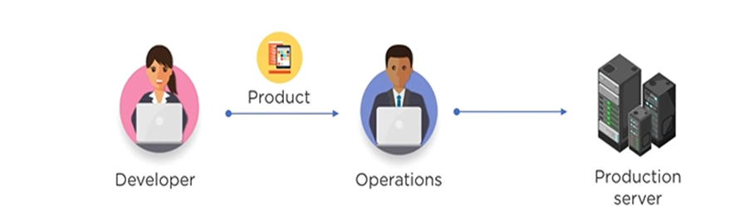
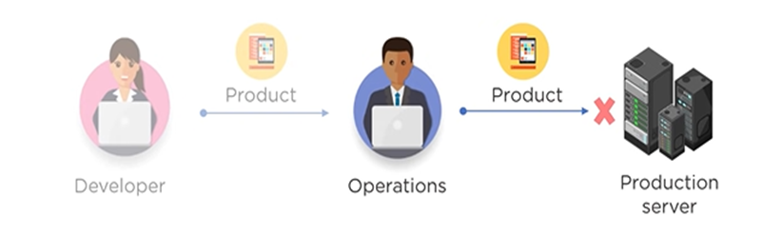
Agile Model
Developers submit the product to operations team for deployment
When product fails in production service the operations team are clueless and sent product back to the development team.

Slide 9
What is DevOps
DevOps word in itself is a combination of two words one is Development and other is Operations. It is neither an application nor a tool; instead, it is just a culture to promote development and Operation process collaboratively. As a result of DevOps implementation, the speed to deliver applications and services has increased.

Slide 10
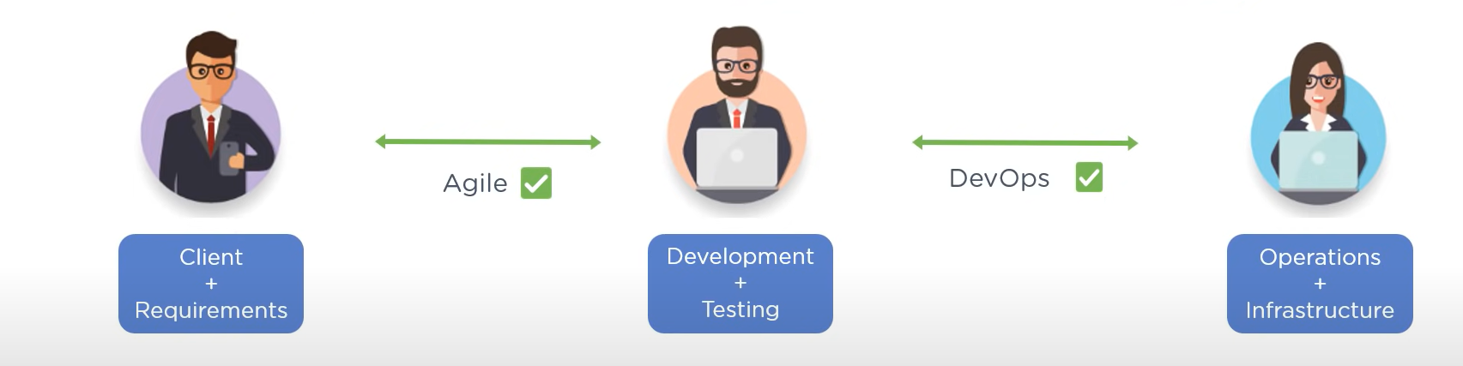
DevOps is an evolution from Agile model

Slide 11
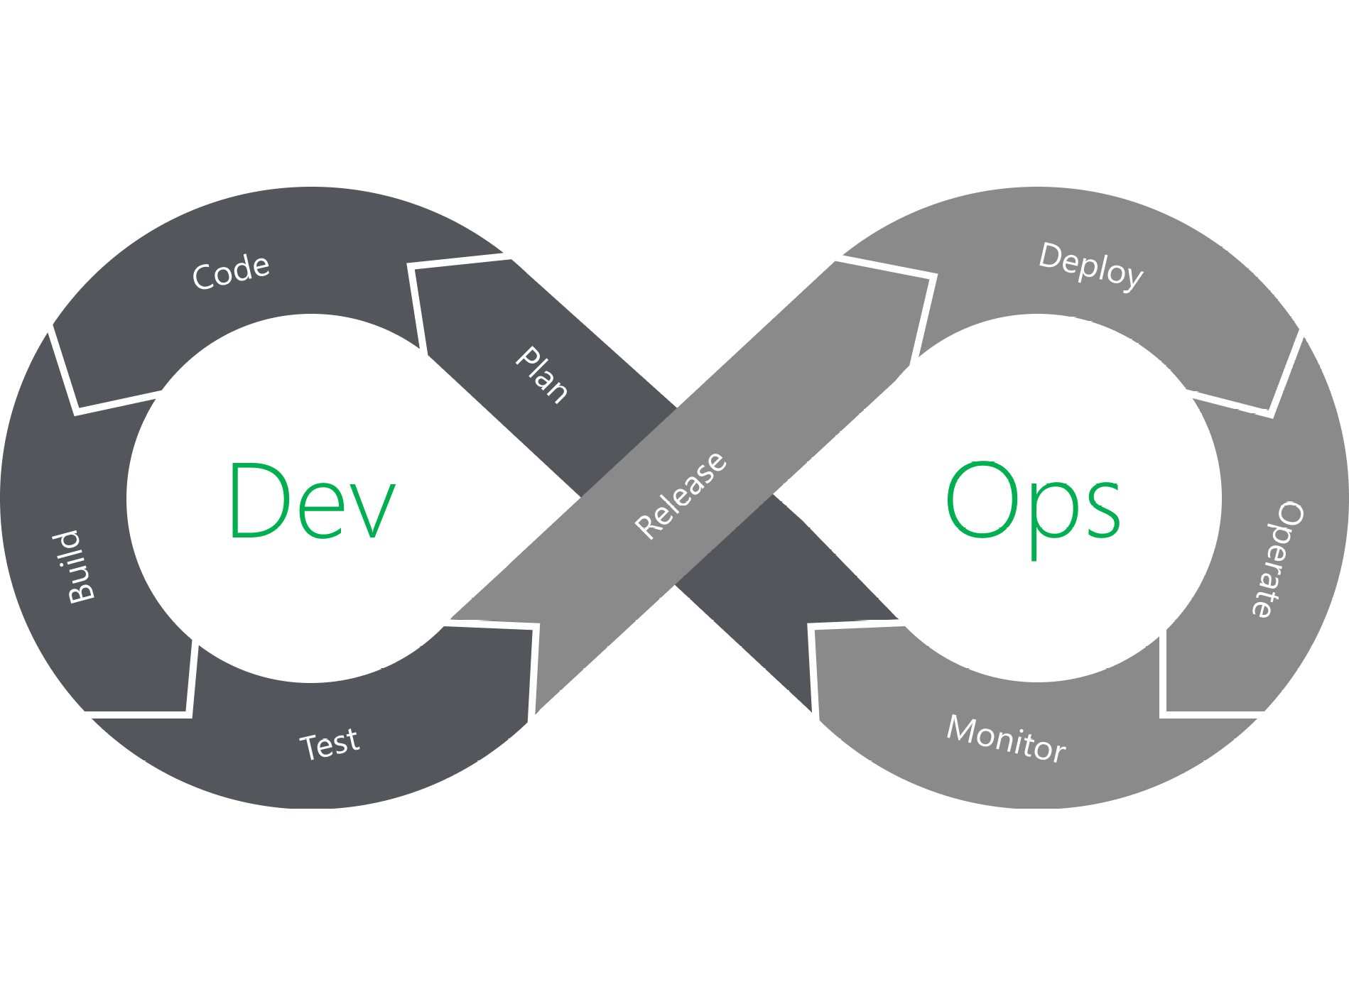
DevOps Phases

Slide 12
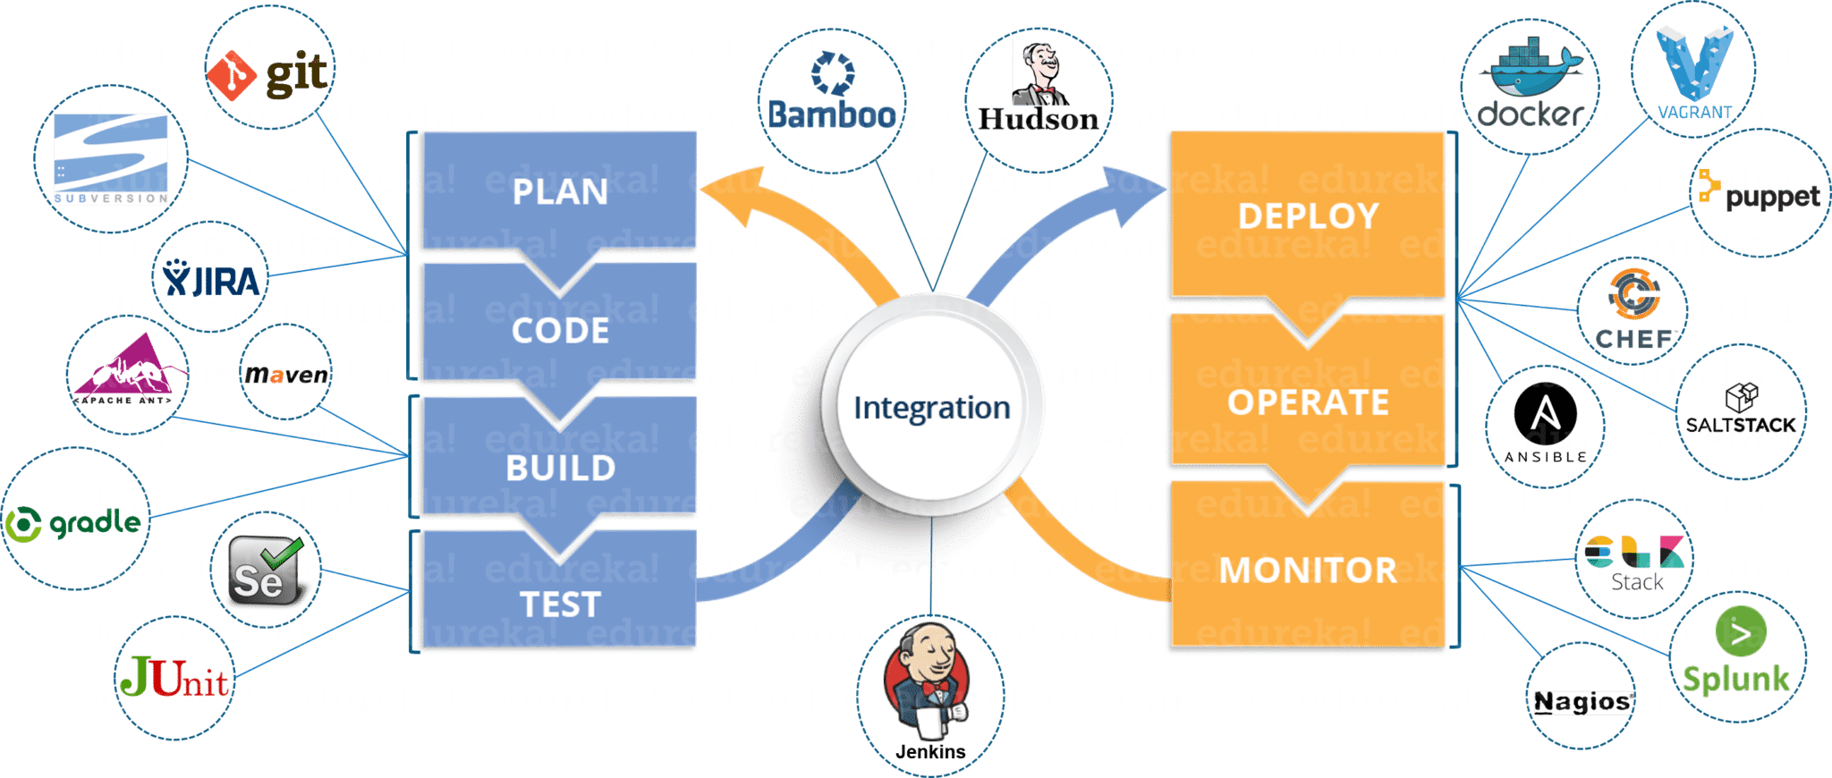
DevOps Tools

Slide 13
DevOps Advantages
Predictability: DevOps decreases the failure rate of new product releases.
Maintainability: The process improves the overall recovery rate at the time of the release event.
Improved Quality: DevOps improves the quality of product development by incorporating infrastructure issues.
Lower Risk: Security aspects are incorporated in SDLC, and the number of defects gets decreased across the product
Cost Efficient: Cost efficiency is improved due to DevOps that is always an aspiration of every business organization.
Stability: DevOps implementation offers a stable and secure operational state.
Streamlined Delivery Process: As DevOps provides streamlined software delivery, marketing effort is reduced up to 50%. It happens due to the mobile application and digital platform.
“DevOps is truly not just the unicorns of big IT hubs like Amazon, Google, Facebook, Netflix etc. but it can be adopted by almost any organization today instead of their sizes.”

